Slide 1

System Requirement
User should be able to edit and delete recipes
Description | A recipe, which can be viewed as an card, should have buttons or a expandable context menu with the option to open a text field to edit the recipe and an opposing option to delete the recipe from the database.
Requires | Access to the local database and a dialog allowing editing.
Pre-Condition | A pre-existing recipe.
Post-Condition | Either an updated recipe entry or the removal of the record from the database.
Side Effects | If deleted, the function will remove other rows from different tables that depend on the main recipe entry.

Slide 2
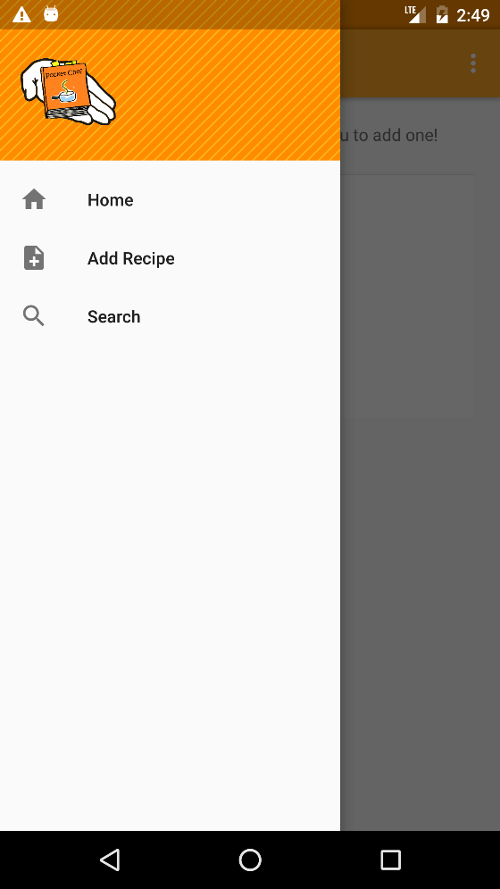
System Requirement
User should be able to search for individual recipes by name of recipe
Description | A text field near the top of the home page should allow the user to type keywords, which will search for recipes in the database based on those keywords.
Requires | Access to the local database and a text field.
Pre-Condition | A pre-existing recipe.
Post-Condition | A list of cards showing the results of the search, if there are any.
Side Effects | None.

Slide 3

System Requirement
User should be able to back up stored recipes and retrieve recipes in case of data loss
Description | A friendly interface within the settings of the app should allow the user to back up the local database to the location of their choice so that they may copy it to another device in case of device failure.
Requires | The local database and file access permissions from the user.
Pre-Condition | An existing database.
Post-Condition | A copy of the database that is in the desired location.
Side Effects | Depending on how the database system serves information, it may leave the database in read-only mode if we have to close existing connections.

